Slide 1
Geology of Nevada
A Discussion to Accompany the Geologic Map of Nevada
Nevada Bureau of Mines and Geology Special Publication 4
1980
John H. Stewart
Presentation by James McNeil

Slide 2
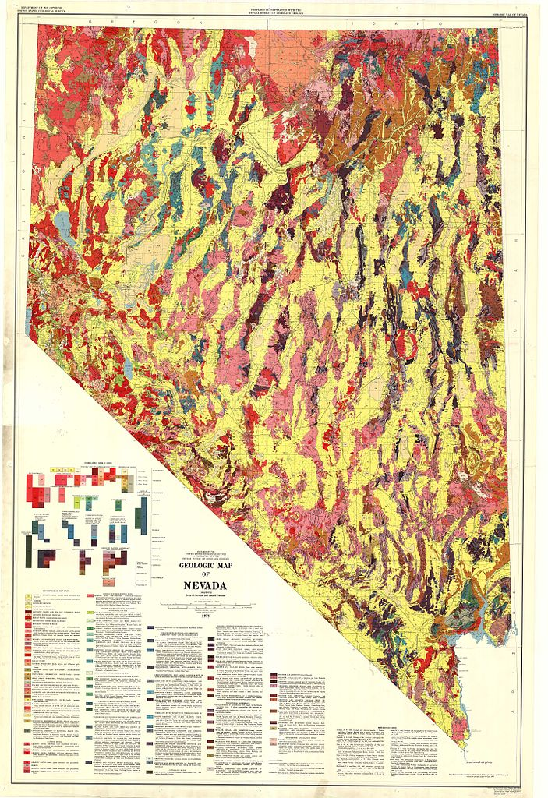
Cenozoic Tectonics
Cenozoic tectonics in Nevada = Extension!
Block-faulted basins and ranges
Most block-faulting occurred in the late Cenozoic
Early and middle Cenozoic tectonic history poorly known
Local faulting and compressional folding locally
pubs.nbmg.unr.edu

Slide 3
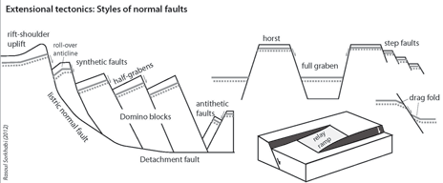
Cenozoic Tectonics
Three basic models of B&R structure
Rotating blocks along listric faults
Horsts and graben system
Elongate rhombohedronal blocks formed by fracturing of the crust along high angle faults (not shown)
geoexpro.com

Slide 4
Cenozoic Tectonics
Evidences for B&R development
Transition from calc-alkalic volcanics
Early to mid Cenozoic – Compressive tectonics
To basaltic volcanics
Late Cenozoic – Extensional tectonics
In general this transition appears ~17 m.y. ago
Appearance of fault-controlled sedimentary basins
Modern sedimentary basins didn’t develop until ~7.5 m.y. ago

Slide 5
Cenozoic Tectonics
Paleocene to middle Eocene
Oldest igneous rocks in Nevada ~43 m.y. (late eocene)
Lack of sedimentary rocks suggests Nevada is an eroding highland
Sheep Pass Formation – (Eocene) east-central Nevada
Rests unconformably on folded and faulted paleozoic rocks
Fluvial lacustrine in broad internal drainage system
Large scale deformation occurred during deposition of Sheep Pass Formation

Slide 6
Cenozoic Tectonics
Middle Tertiary deformation
Elko Formation (Eocene and Oligocene(?))
Strongly folded ~45° and locally folded to partially overturned syncline
Folding younger than 37-38 m.y. tuff but older than 33-35 m.y. tuff in unconformably overlying unit
Boulder conglomerates in Titus canyon ~200 ft (60 m) thick
Possible landslide deposits from thrust faulting

Slide 7
Cenozoic Tectonics
Widespread igneous activity in late Eocene and early Oligocene prior to late Cenozoic extension
Lack of relief in mid Tertiary
Widespread distribution of ash-flow sheets
Uniform stratigraphic sequence of ash-flow units from area to area in central and eastern Nevada

Slide 8
Cenozoic Tectonics
Extension begins ~17 m.y. ago
Extensional block faulting
Basins trap sediments and volcanic products erupted during extension
Valley fill in major valleys
100 m – 3,000 m
Structural relief between lowest bedrock under valleys to highest adjacent mountain
2,000 m – 5,000 m

Slide 9
Cenozoic Tectonics
Regional extension required
Normal faults bounding mountains or valleys that dip ~60° require 1 mile of extension for 2 miles of dip-slip
Horst and graben structure
10 – 20 % extension estimates
Tilted blocks along downward-flattening faults
30 – 50 % (up to 100 %)

Slide 10
Cenozoic Tectonics
Southern Nevada
Two systems of faulting
NW trending – In rocks older than 17 m.y.
NE trending – cuts 14 m.y. tuff not cut by older set of faults
Widespread tuff deposition indicates low relief at 11 m.y. ago
Tuff @ 7 m.y. ago suggests topography similar to today

Slide 11
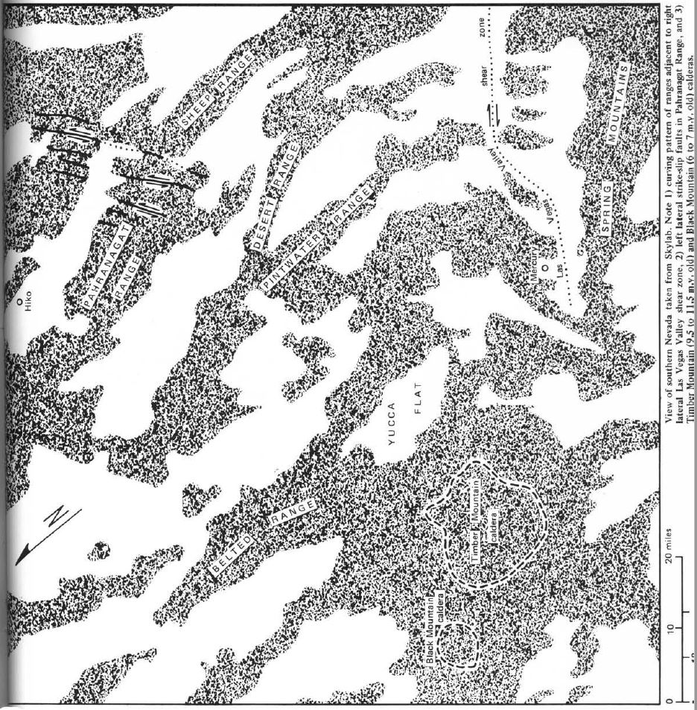
Strike Slip Faults
NW trending right-lateral – Walker Lane (up to 32 km in Washoe Valley)
NW trending right-lateral – Las Vegas Valley Shear Zone (32-68 km)
15-11 m.y. displacement
15 m.y. disrupted strata
11 m.y. undeformed volcanic strata

Slide 12
Historic Ruptures
Historic ruptures of the Central Nevada Seismic Belt (1915-1954)
Pleasant Valley 1915
Cedar Mountain 1932
Excelsior Mountain 1934
Rounbow Mountain & Dixie Valley-Fairview Peak 1954
Indicates strike slip and extensional displacement and continuation of present day tectonics

Slide 13
Cenozoic Tectonics: Conclusions
Major takeaway: Importance of volcanics and cross cutting relationships for constraining the timing of tectonic events
Origin of late Cenozoic extensional and strike slip faulting
Wrench faulting concept relates extension to oblique tensional fragmentation within a broad belt of right-lateral movement along western North America

Slide 14
Cenozoic Tectonics: Conclusions
Pacific plate / North American plate motion
SAF dominated deformation
Slip on related zones → Walker Lane
Producing tensional crustal fragmentation oblique to the trend of the SAF

